Slide 1
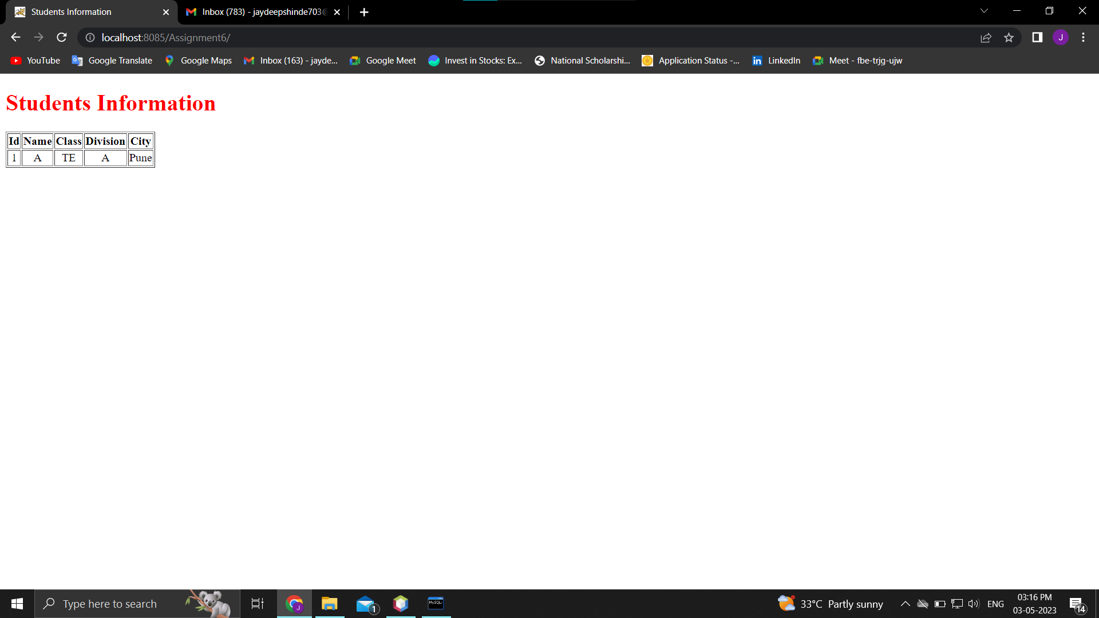
Assignment 6 Output:-

